Slide 1
Mini Popper | Colt poppers | Pepper poppers | Plates | Wall feet
2 | 5 | 2 | 0 | 61
Bay | Stage | Target Type | Count | NS | Total | Hard Cover
A3 | What Is My Purpose? | USPSA | 10 | 2 | 12 | 1 Left Diag 2 Right Diag 1 50%
A2 | All Open? | IPSC | 12 |  | 12
B1 | Odd | IPSC | 12 | 2 | 14 | 1 Tux 1 Right Diag
B2 | 09-10 | USPSA | 6 | 2 | 8
B3 | Be Careful What You Wish For | IPSC | 10 | 1 | 11 | 1 Right Diag 2 50%
B4 | Just for Mike | IPSC | 3 |  | 3

Slide 2
Prop | Stage
Swinger | 1 – A3
Stomp pad | 1 – A3
Swinger | 6 – B4
Drop turner | 6 – B4

Slide 3

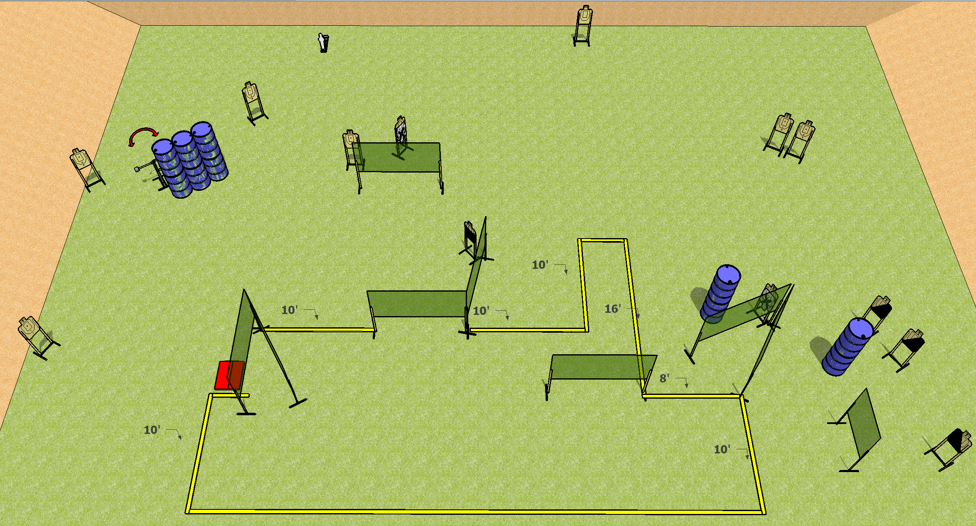
 | Dothan Practical Shooters – USPSA Match What Is My Purpose? Course Designer : Drew Coleman Bay: A3
Round Count 29 rounds 14 USPSA 1 mini popper
Equipment List 17 wall feet Stomp box + swinger

Slide 4
What Is My Purpose?
Written Stage Briefing
Scoring: Comstock Rounds: 29
Targets: 14 USPSA, 1 Steel
Handgun start position: anywhere inside the shooting area, wrists below belt. Handgun is loaded and holstered.
PCC start position: anywhere inside the shooting area, stock on belt. Loaded carbine is held with both hands, safety on.
Stage Procedure: on the audible start signal, engage targets as they become available from within the shooting area. The swinger is activated by the stomp pad and remains visible at rest.

Slide 5
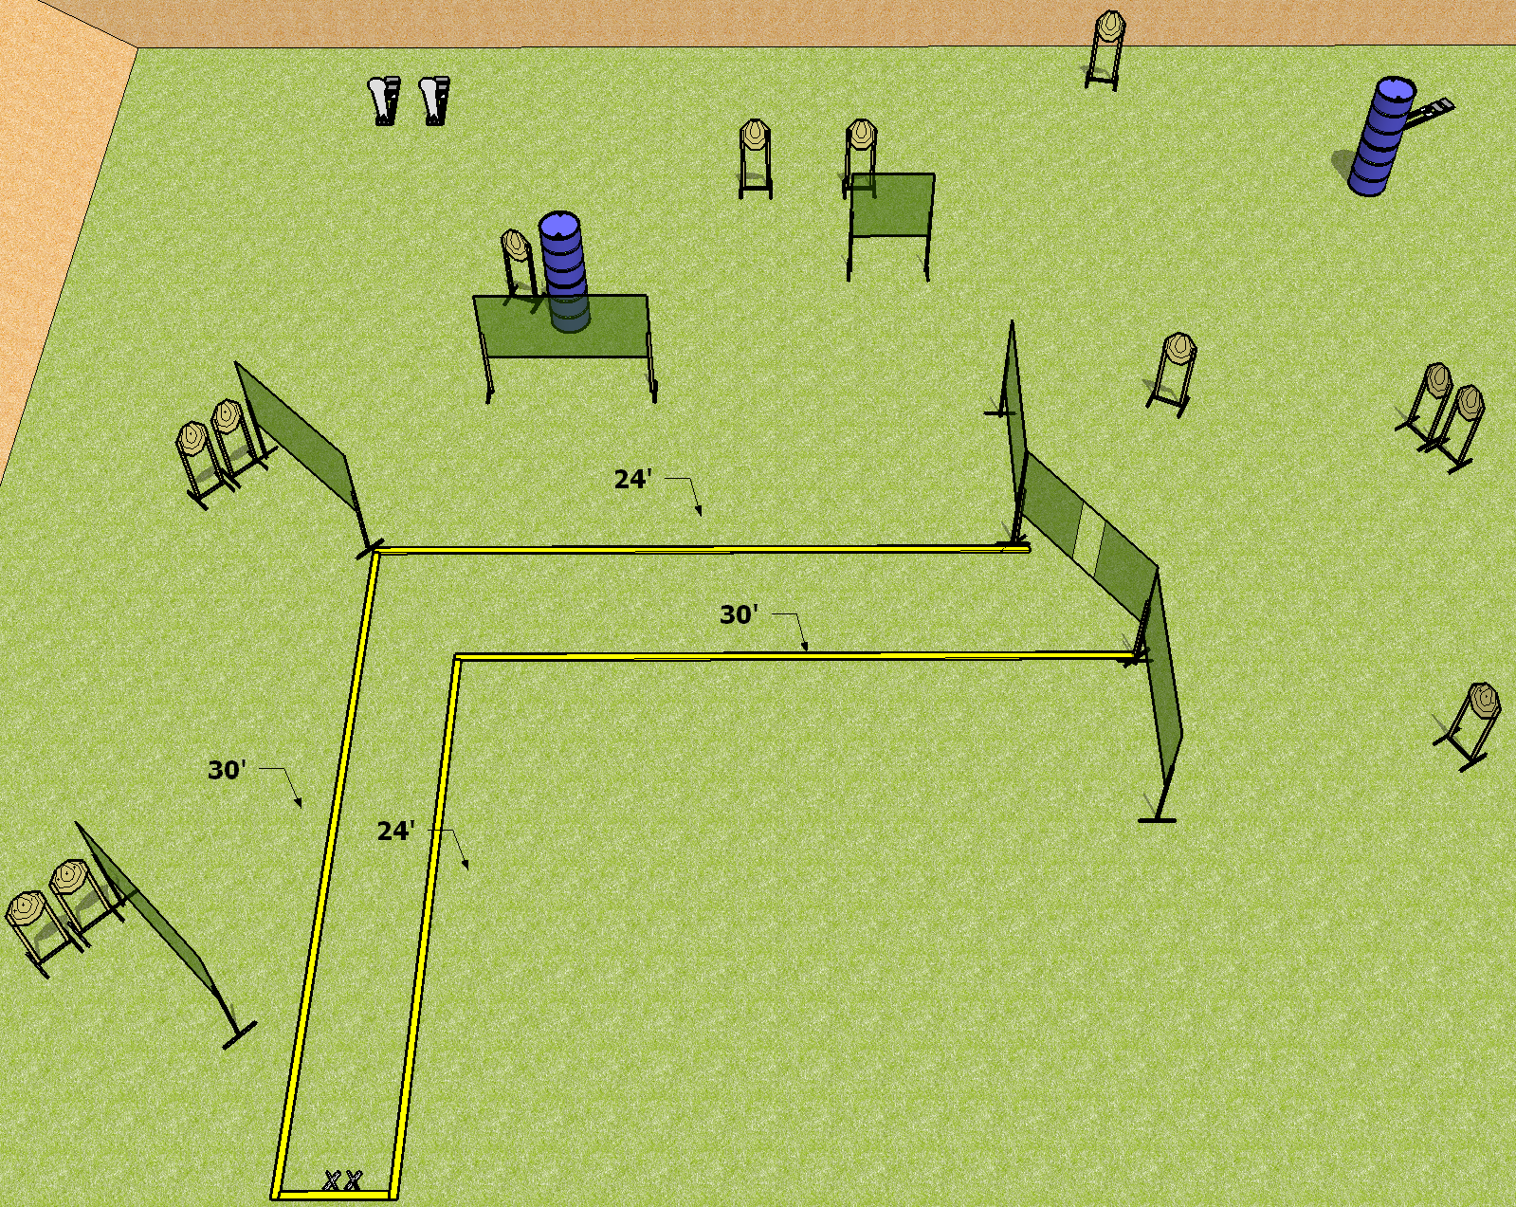
 | Dothan Practical Shooters – USPSA Match All Open? Course Designer : Drew Coleman Bay: A2
Round Count 27 rounds 12 IPSC 3 colt poppers
Equipment List 14 wall feet

Slide 6
All Open?
Written Stage Briefing
Scoring: Comstock Rounds: 27 rounds
Targets: 12 IPSC, 3 steel
Handgun start position: Heels on X’s, wrists below belt. Handgun is loaded and holstered.
PCC start position: heels on X’s, stock on belt. Loaded carbine is held with both hands, safety on.
Stage Procedure: on the audible start signal, engage targets as they become available from within the shooting area.

Slide 7
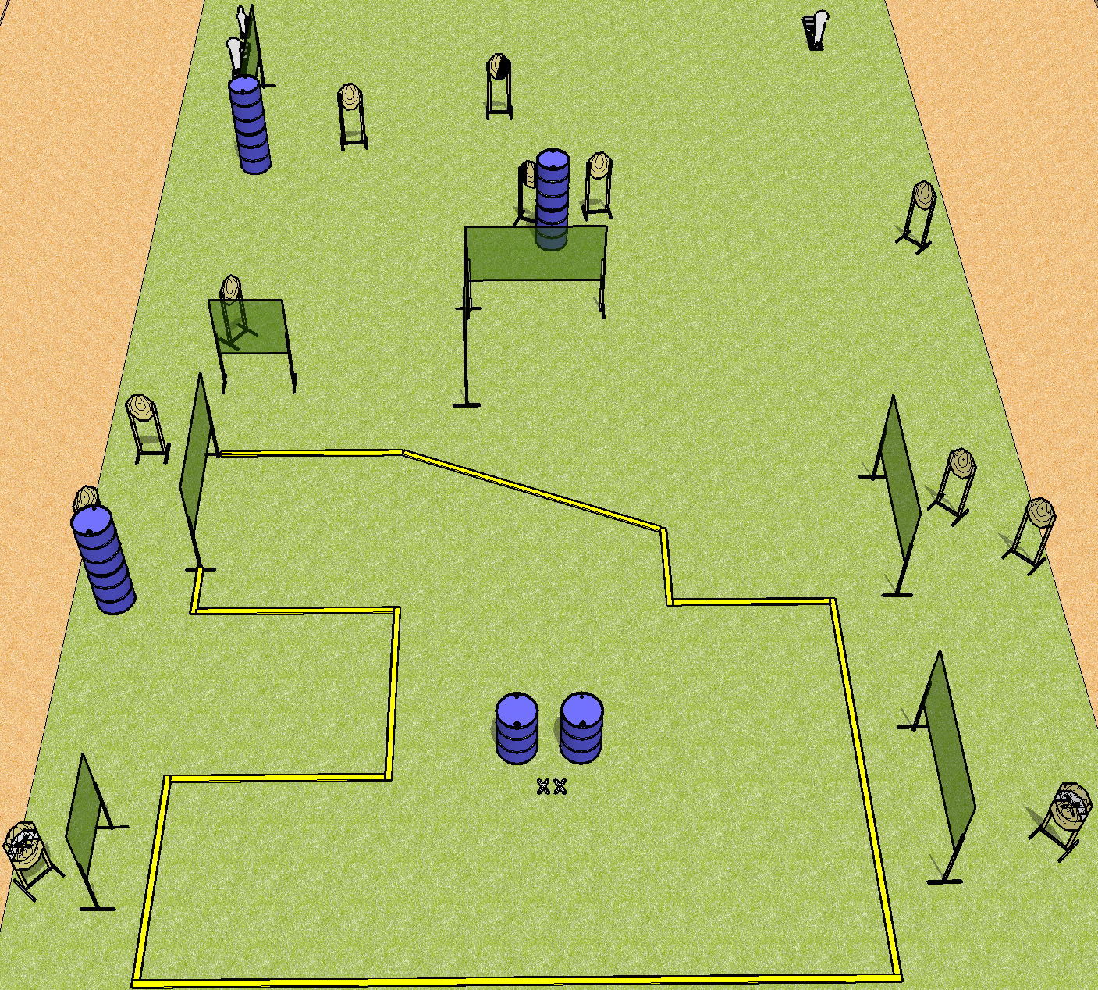
 | Dothan Practical Shooters – USPSA Match Odd Course Designer : Drew Coleman Bay: B1
Round Count 31 rounds 14 IPSC 2 colt poppers, 1 mini popper
Equipment List 13 wall feet 1 tux + 1 right diag 14 targets (12 + 2NS)

Slide 8
Odd
Written Stage Briefing
Scoring: Comstock Rounds: 31
Targets: 14 IPSC, 3 steel
Start position: feet on X’s, palms on marks. Firearm is unloaded on either barrel, unpropped. First magazine to be used on stage is on the opposite barrel.
Stage Procedure: on the audible start signal, engage targets as they become available from within the shooting area.

Slide 9
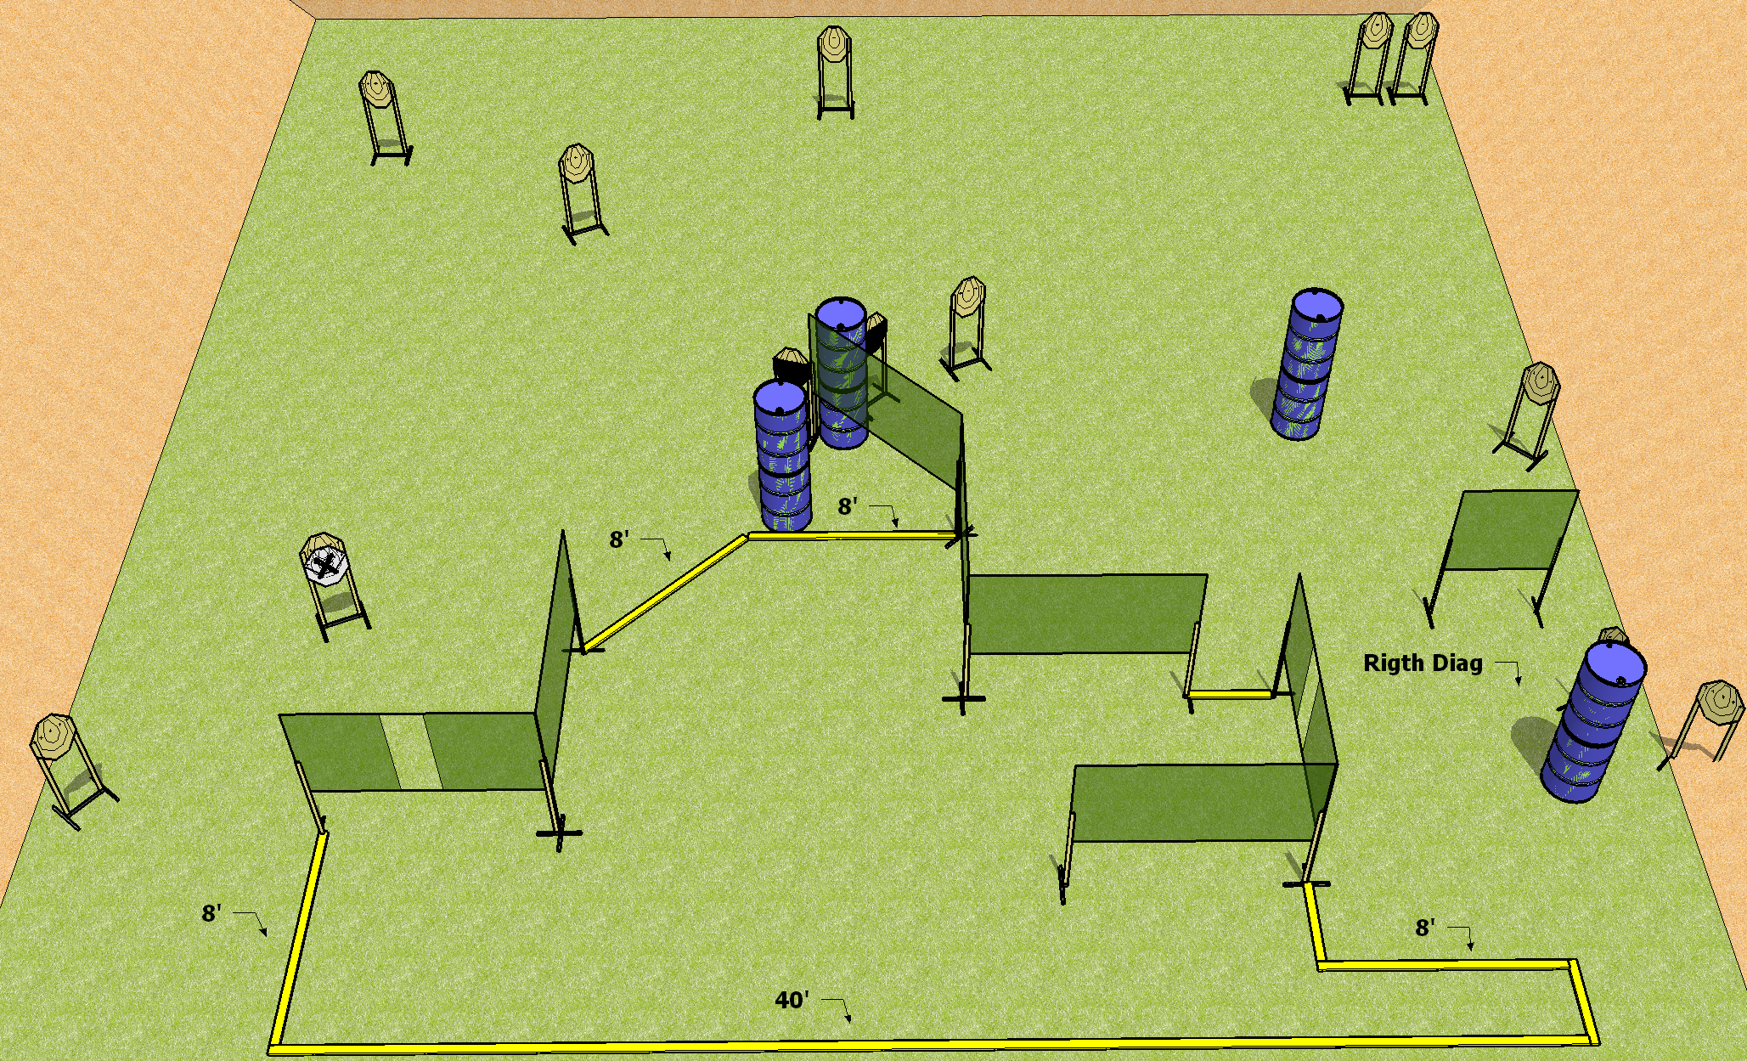
 | Dothan Practical Shooters – USPSA Match Be Careful What You Wish For Course Designer : Drew Coleman Bay: B3
Round Count 26 rounds 13 IPSC
Equipment List 13 wall feet 2 50%, 1 right diag 11 targets (10 + 1NS)

Slide 10
Be Careful What You Wish For
Written Stage Briefing
Scoring: Comstock Rounds: 26 rounds
Targets: 13 IPSC
Handgun start position: anywhere inside the shooting area, wrists below belt. Handgun is loaded and holstered.
PCC start position: anywhere inside the shooting area, stock on belt. Loaded carbine is held with both hands, safety on.
Stage Procedure: on the audible start signal, engage targets as they become available from within the shooting area.

Slide 11
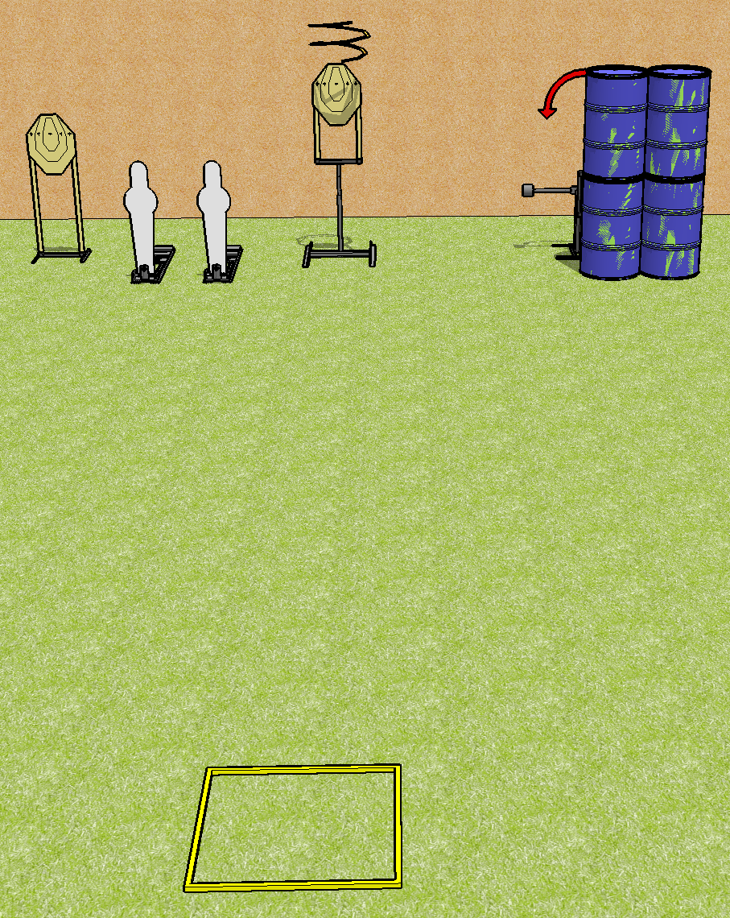
 | Dothan Practical Shooters – USPSA Match Just For Mike Course Designer : Drew Coleman Bay: B4
Round Count 8 rounds 3 IPSC, 2 pepper poppers
Equipment List Drop turner + swinger + activator Shooting box

Slide 12
Just for Mike
Written Stage Briefing
Scoring: Comstock Rounds: 8
Targets: 3 IPSC, 2 steel
Handgun start position: inside the shooting area, facing uprange, wrists above shoulders. Handgun is loaded and holstered.
PCC start position: inside the shooting area, wrists above shoulders. Loaded carbine is held with both hands, safety on.
Stage Procedure: on the audible start signal, engage targets as they become available from within the shooting area. P2 activates the drop turner and the swinger. The drop turner is a disappearing target and the swinger remains visible at rest.
Appendix A3, Facing uprange: Face and feet pointing directly (180 degrees) away from the backstop with shoulders and hips square to the backstop. A natural, "toes out" stance is acceptable and meets the standard of feet pointing directly away from the backstop, as long as both feet do not point in the same direction, and the rest of the position requirements are satisfied.

